Slide 1

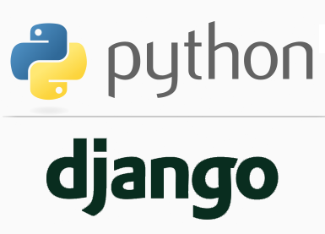
FULL STACK WEB DEVELOPMENT WITH DJANGO
Lecture 4

Slide 2

Today’s Agenda
Developing First Django Project
Starting A Django Project
Django Project V/s Django App
Creating A Django Project
Understanding The File Structure
Running The Django Project
A Little Bit About Migrations

Slide 3
Starting A Django Project
Once we’ve installed Python and Django, we can take the first step in developing a Django application by creating a Django project.
But before we do that , we must have a very clear understanding about the 2 terms which are Django Project and Django App , which beginners find very confusing

Slide 4
Django App V/s Django Project ?
A Django project refers to the entire website and all it’s parts.
A Django app refers to a submodule of the project

Slide 5
Django App V/s Django Project ?
For example , let us consider Facebook .
In terms of Django , the entire Facebook website is a Django project , while the individual components of Facebook website which offer different functionalities like login , post uploading , account settings , time line etc are Django apps
So we can say that a Django project is composed of one or more Django apps

Slide 6
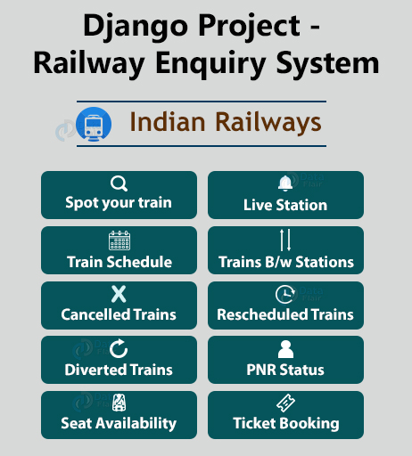
Django App V/s Django Project ?

Slide 7
Creating A Django Project
To create a new Django project we’ll be using a special command to auto-generate the folders, files and code that make up a Django project.
But before writing the command make sure you are in your projects folder( in our case it was d:\djangoexamples\myfirstproject) and running the Virtual Environment( in our case it was myenv)

Slide 8
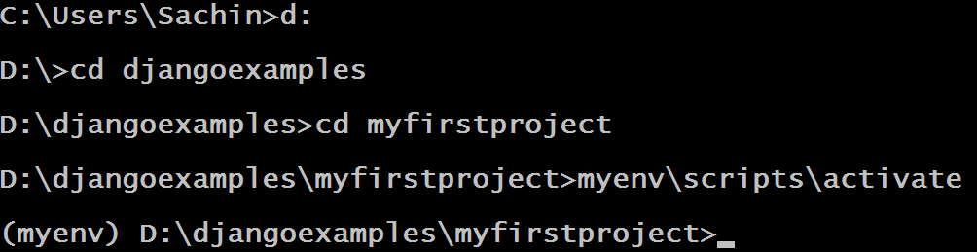
Creating A Django Project

Slide 9
Creating A Django Project
Once we have activated our virtual environment , the next task is to create the Django project, which is done using the following command:
django-admin startproject djangoprojectname
where djangoprojectname is the name of our Django project
For example:
django-admin startproject first_project

Slide 10
Creating A Django Project
This command will automatically create a first_project folder in our myfirstproject folder, as well as all the necessary files for a basic, but fully functioning Django website

Slide 11
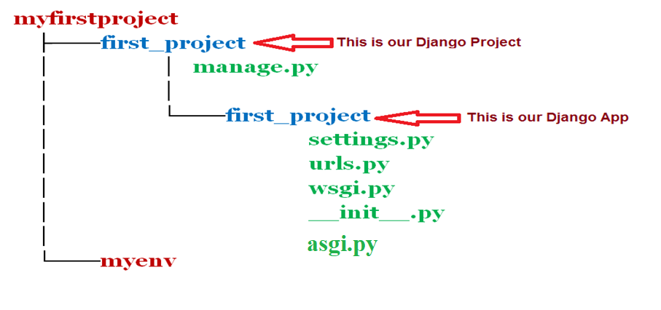
Creating A Django Project
Following is the folder and file structure the previous command will create:

Slide 12
Details Of Folder/File Structure
first_project: (outer folder)
The outer first_project folder is our Django project.
Django created this folder and its contents when we ran the startproject command .
first_project: (inner folder)
The inner first_project folder is our Django website application.
This is the one application that Django creates automatically for us.
Because Django is a web framework, it assumes we are going to build a website app.

Slide 13
Details Of Folder/File Structure
__init__.py : This is a blank Python script that due to its special name let’s Python know that this directory can be treated as a package.
settings.py : This is where we will store all our project settings
urls.py: This is a Python script that will store all the URL patterns for our project. Url is basically the path to different pages of our web application.

Slide 14
Details Of Folder/File Structure
wsgi.py:This is a Python script that acts as the Web Server Gateway Interface. It will later on help us deploy our web app to production.
asgi.py:Same as wsgi.py , but allows our application to work in asynchronous mode.
manage.py:This is a Python script that we will use a lot. It will be associated with many commands as we build our web app!

Slide 15
Running The Django Project
Let’s verify our whether our Django project works.
Follow the given steps :
Activate the virtual environment if it is not activated
Go to the outer first_project directory and run the following command:
python manage.py runserver
This will start the Django development server – a lightweight Web server written in Python.
The development server comes bundled with Django and was created so that we can develop things rapidly

Slide 16
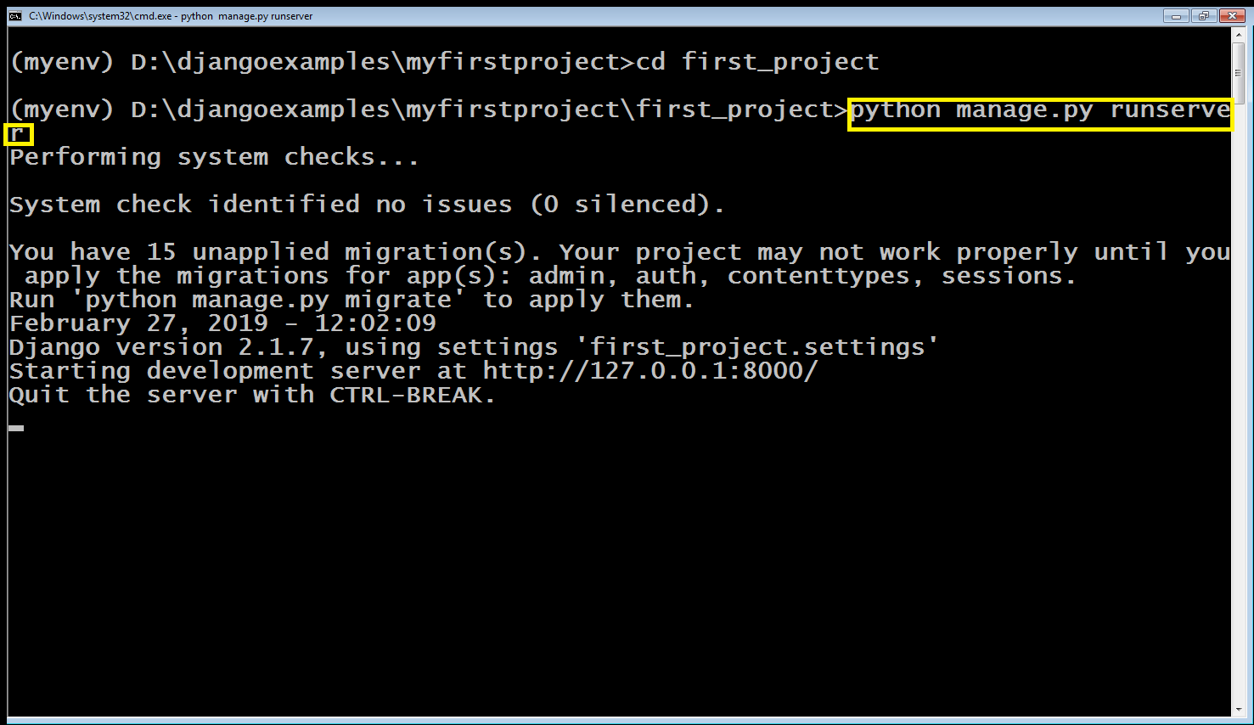
Running The Django Project

Slide 17
Running The Django Project
When the server starts, Django will output a few messages before telling us that the development server is up and running at http://127.0.0.1:8000/.
Here , 127.0.0.1 is the IP address for local host, or our local computer and the number 8000 on the end is telling us that Django is listening at port 8000 on our local host.

Slide 18
Running The Django Project
Now that the server is running, we can visit http://127.0.0.1:8000/ with our web browser and we’ll see Django’s default welcome page, complete with a cool animated rocket (as shown in next slide)

Slide 19
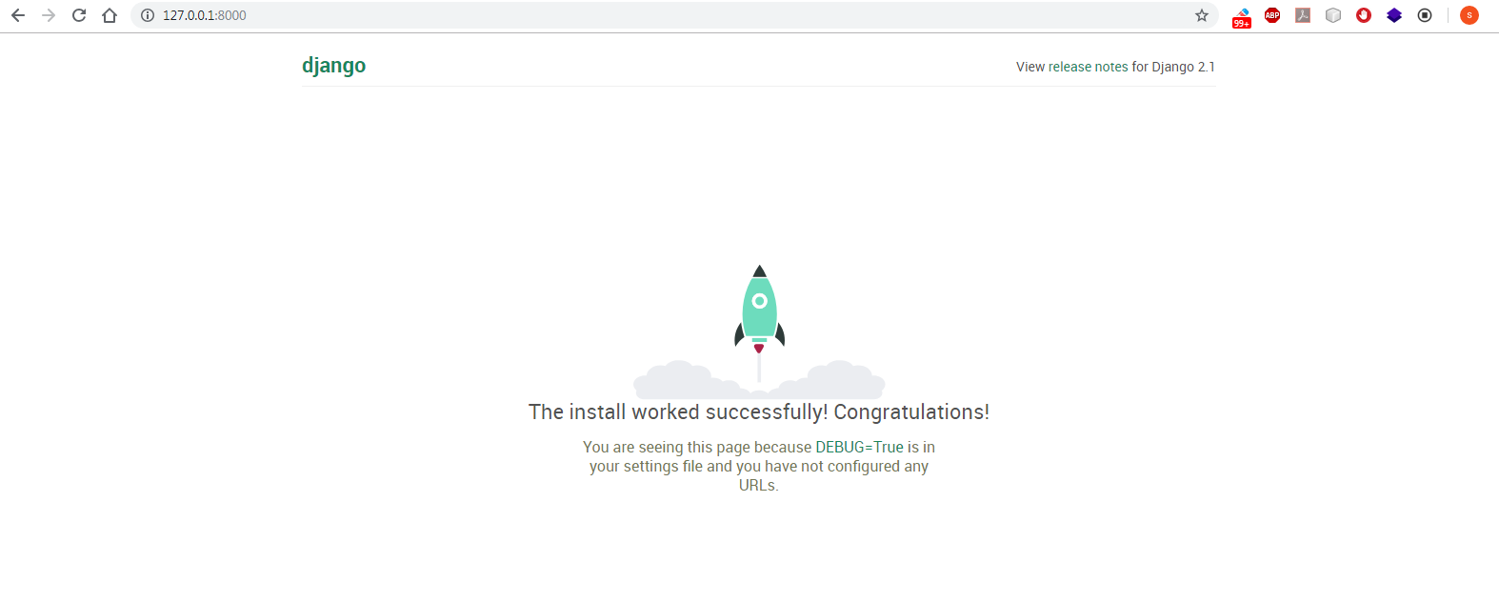
Running The Django Project

Slide 20
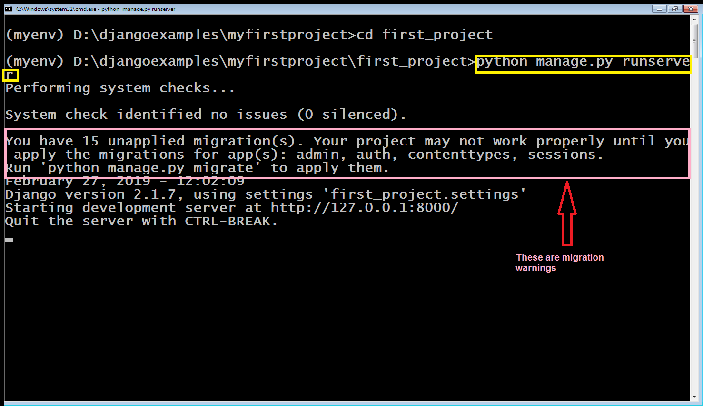
A Little Bit About Migrations Warning!
When we launched the server , you must have noticed that we got a warning from Django related to migrations

Slide 21
A Little Bit About Migrations Warning!
This raises a question that what is migration ?
In Django World , Migrations are a way of propagating the changes made in the model , to the database schema.
This raises 2 more questions that what is a database schema and what are models ?

Slide 22
A Little Bit About Migrations Warning!
Like Python , Django is also designed to work with relational databases like Oracle, PostgreSQL, MySQL, or SQLite.
In a relational database:
Data is organized in tables.
Every table has a certain number of columns.
Each column has a specific datatype, like a string of a certain maximum length or a positive integer.
The description of all tables with their columns and their respective datatypes is called a database schema.

Slide 23
A Little Bit About Migrations Warning!
All database systems supported by Django use the language SQL
SQL stands for Structured Query Language and is used to create, read, update and delete data in a relational database.
SQL is also used to create, change, and delete the database tables themselves.
But working directly with SQL can be quite cumbersome, so to make our life easier, Django comes with an object-relational mapper, or ORM for short.

Slide 24
A Little Bit About Migrations Warning!
The ORM maps the relational database to the world of object oriented programming. Instead of defining database tables in SQL, we write Django models in Python.
Our models define database fields, which correspond to the columns in their database tables.
Finally Django converts our models into database tables and this is called migrations.
Additionally, whenever we make a change to our models, like adding a field, the database has to be changed too. Migrations handle that as well.
We will discuss migrations when we will learn Models in Django

